Slide 1
CPSC 7373: Artificial Intelligence
Lecture 6: Machine Learning
Jiang Bian, Fall 2012
University of Arkansas at Little Rock

Slide 2
Machine Learning
ML is a branch of artificial intelligence
  Take empirical data as input
  And yield patterns or predictions thought to be features of the underlying mechanism that generated the data.
Three frontiers for machine learning:
  Data mining: using historical data to improve decisions
    Medical records -> medical knowledge
  Software applications that we can’t program
    Autonomous driving
    Speech recognition
  Self learning programs
    Google ads that learns user interests

Slide 3
Machine Learning
Bayes networks:
  Reasoning with known models
Machine learning:
  Learn models from data
Supervised Learning
Unsupervised learning

Slide 4
Patient diagnosis
Given:
  9714 patient records, each describing a pregnancy and birth
  Each patient record contains 215 features
Learn to predict:
  Classes of future patients at high risk for Emergency Cesarean Section

Slide 5
Datamining result
One of 18 learned rules:
If No previous vaginal delivery, and
Abnormal 2nd Trimester Ultrasound, and
Mal-presentation at admission
Then Probability of Emergency C-Section is 0.6
Over training data: 26/41 = .63,
Over test data: 12/20 = .60

Slide 6
Credit risk analysis
Rules learned from synthesized data:
If Other-Delinquent-Accounts > 2, and
Number-Delinquent-Billing-Cycles > 1
Then Profitable-Customer? = No
[Deny Credit Card application]
If Other-Delinquent-Accounts = 0, and
(Income > $30k) OR (Years-of-Credit > 3)
Then Profitable-Customer? = Yes
[Accept Credit Card application]

Slide 7
Examples – cond.
Companies that are famous for using machine learning:
  Google: web mining (PageRank, search engine, etc.)
  Netflix: DVD Recommendations
    The Netflix prize ($1 million) and the recommendation problem
  Amazon: Product placement

Slide 8
Self driving car
Stanley (Standford) DARPA Grand Challenge (2005 winner)
https://www.youtube.com/watch?feature=player_embedded&v=Q1xFdQfq5Fk&noredirect=1#!

Slide 9
Taxonomy
What is being learned?
  Parameters (e.g., probabilities in the Bayes network)
  Structure (e.g., the links in the Bayes network)
  Hidden concepts/groups (e.g., group of Netflix users)
What from?
  Supervised (e.g., labels)
  Unsupervised (e.g., replacement principles to learn hidden concepts)
  Reinforcement learning (e.g., try different actions and receive feedbacks from the environment)
What for?
  Prediction (e.g., stock market)
  Diagnosis (e.g., to explain something)
  Summarization (e.g., summarize a paper)
How?
  Passive/Active
  Online/offline
Outputs?
  Classification v.s., regression (continuous)
Details?
  Generative (general idea of the data) and discriminative (distinguish the data).

Slide 10
Supervised learning
Each instance has a feature vector and a target label
  f(X_{m}) = y_{m} => f(x) = y

Slide 11
Quiz
Which function is preferable?
  f_{a} OR f_{b} ??
fb
y
fa
x

Slide 12
Occam’s razor
Everything else being equal, choose the less complex hypothesis (the one with less assumptions).
FIT
Low Complexity
unknown data error
FIT
OVER FITTING error
Training data error
Complexity

Slide 13
Spam Detection
Dear Sir,
First, I must solicit your confidence in this transaction, this is by virtue of its nature being utterly confidential and top secret …
TO BE REMOVED FROM FUTURE MAILLINGS, SIMPLY REPLY TO THIS MESSAGE AND PUT “REMOVE” IN THE SUBJECT
99 MILLION EMAIL ADDRESSES FOR $99
OK, I know this is blatantly OT but I’m beginning to go instance. Had an old Dell Dimension XPS sitting in the corner and decided to put it to use. I know it was working pre being stuck in the corner, but when I plugged it in, hit the power, nothing happened.

Slide 14
Spam Detection
SPAM
Email
f(x) ?
HAM
Bag Of Words (BOW)
e.g., Hello, I will say hello
Dictionary [hello, I, will, say]
Hello – 2
I – 1
will – 1
say – 1
Dictionary [hello, good-bye]
Hello – 2
Good-bye - 0

Slide 15
Spam Detection
SPAM
  Offer is secret
  Click secret link
  Secret sports link
HAM
  Play sports today
  Went play sports
  Secret sports event
  Sport is today
  Sport costs money
Size of Vocabulary: ???
P(SPAM) = ???
Notes:
12 different words.
P(SPAM) = 3/8 (MAXIUM LIKELIHOOOD)

Slide 16
Maximum Likelihood
SSSHHHHH
  P(S) = π
11100000
P(data)
  P(y_{i}) = π (if y_{i} = S)
  = 1 – π (if y_{i} = H)
Notes:
And what we care about is what's our prior probability of spam that maximizes the likelihood of this data?

Slide 17
Quiz
Maximum Likelihood Solutions:
  P(“SECRET”|SPAM) = ??
  P(“SECRET”|HAM) = ??
SPAM
  Offer is secret
  Click secret link
  Secret sports link
HAM
  Play sports today
  Went play sports
  Secret sports event
  Sport is today
  Sport costs money

Slide 18
Quiz
Maximum Likelihood Solutions:
  P(“SECRET”|SPAM) = 1/3
  P(“SECRET”|HAM) = 1/15
SPAM
  Offer is secret
  Click secret link
  Secret sports link
HAM
  Play sports today
  Went play sports
  Secret sports event
  Sport is today
  Sport costs money

Slide 19
Relationship to Bayes Networks
We built a Bayes network where the parameters of the Bayes networks are estimated using supervised learning by a maximum likelihood estimator based on training data.
The Bayes network has at its root an unobservable variable called spam, which is binary, and it has as many children as there are words in a message, where each word has an identical conditional distribution of the word occurrence given the class spam or not spam.
Spam
DICTIONARY HAS 12 WORDS:
OFFER, IS, SECRET, CLICK, SPORTS, …
How many parameters?
W1
W2
W3
P(“SECRET”|SPAM) = 1/3
P(“SECRET”|HAM) = 1/15

Slide 20
SPAM Classification - 1
SPAM
  Offer is secret
  Click secret link
  Secret sports link
HAM
  Play sports today
  Went play sports
  Secret sports event
  Sport is today
  Sport costs money
Message M=“SPORTS”
P(SPAM|M) = ???

Slide 21
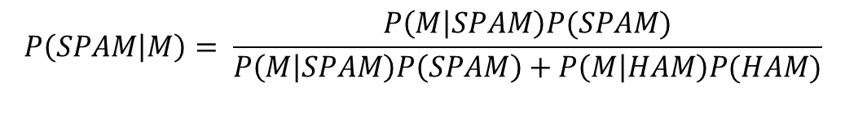
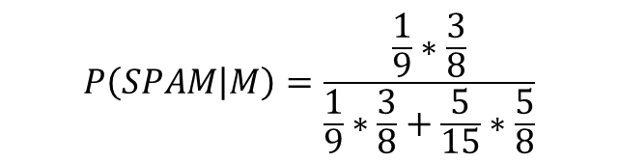
SPAM Classification - 1
Message M=“SPORTS”
P(SPAM|M) = 3/18
$$P\left(SPAM | M\right)= \frac{P\left(M | SPAM\right)P(SPAM)}{P\left(M | SPAM\right)P\left(SPAM\right)+P\left(M | HAM\right)P(HAM)}$$
SPAM
  Offer is secret
  Click secret link
  Secret sports link
HAM
  Play sports today
  Went play sports
  Secret sports event
  Sport is today
  Sport costs money
$$P\left(SPAM | M\right)=\frac{\frac{1}{9}∗\frac{3}{8}}{\frac{1}{9}∗\frac{3}{8}+\frac{5}{15}∗\frac{5}{8}}$$

Slide 22
SPAM Classification - 2
SPAM
  Offer is secret
  Click secret link
  Secret sports link
HAM
  Play sports today
  Went play sports
  Secret sports event
  Sport is today
  Sport costs money
M = “SECRET IS SECRET”
P(SPAM|M) = ???

Slide 23
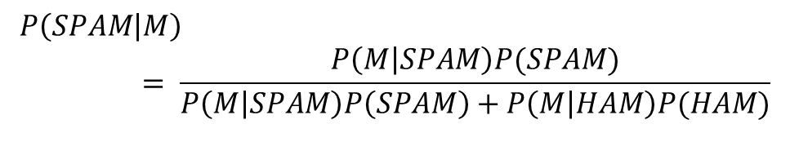
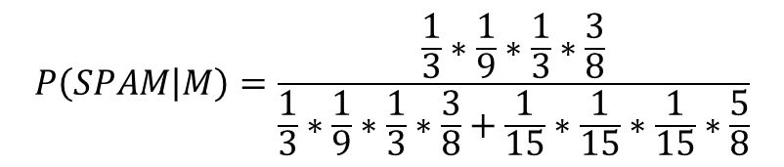
SPAM Classification - 2
M = “SECRET IS SECRET”
P(SPAM|M) = 25/26 = 0.9615
SPAM
  Offer is secret
  Click secret link
  Secret sports link
HAM
  Play sports today
  Went play sports
  Secret sports event
  Sport is today
  Sport costs money
$$P\left(SPAM | M\right)= \frac{P\left(M | SPAM\right)P(SPAM)}{P\left(M | SPAM\right)P\left(SPAM\right)+P\left(M | HAM\right)P(HAM)}$$
$$P\left(SPAM | M\right)=\frac{\frac{1}{3}∗\frac{1}{9}∗\frac{1}{3}∗\frac{3}{8}}{\frac{1}{3}∗\frac{1}{9}∗\frac{1}{3}∗\frac{3}{8}+\frac{1}{15}∗\frac{1}{15}∗\frac{1}{15}∗\frac{5}{8}}$$

Slide 24
SPAM Classification - 3
SPAM
  Offer is secret
  Click secret link
  Secret sports link
HAM
  Play sports today
  Went play sports
  Secret sports event
  Sport is today
  Sport costs money
M = “TODAY IS SECRET”
P(SPAM|M) = ???

Slide 25
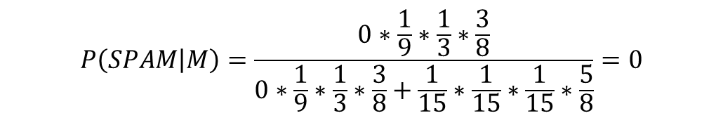
SPAM Classification - 3
M = “TODAY IS SECRET”
P(SPAM|M) = 0
SPAM
  Offer is secret
  Click secret link
  Secret sports link
HAM
  Play sports today
  Went play sports
  Secret sports event
  Sport is today
  Sport costs money
$$P\left(SPAM | M\right)= \frac{P\left(M | SPAM\right)P(SPAM)}{P\left(M | SPAM\right)P\left(SPAM\right)+P\left(M | HAM\right)P(HAM)}$$
$$P\left(SPAM | M\right)=\frac{0∗\frac{1}{9}∗\frac{1}{3}∗\frac{3}{8}}{0∗\frac{1}{9}∗\frac{1}{3}∗\frac{3}{8}+\frac{1}{15}∗\frac{1}{15}∗\frac{1}{15}∗\frac{5}{8}}=0$$

Slide 26
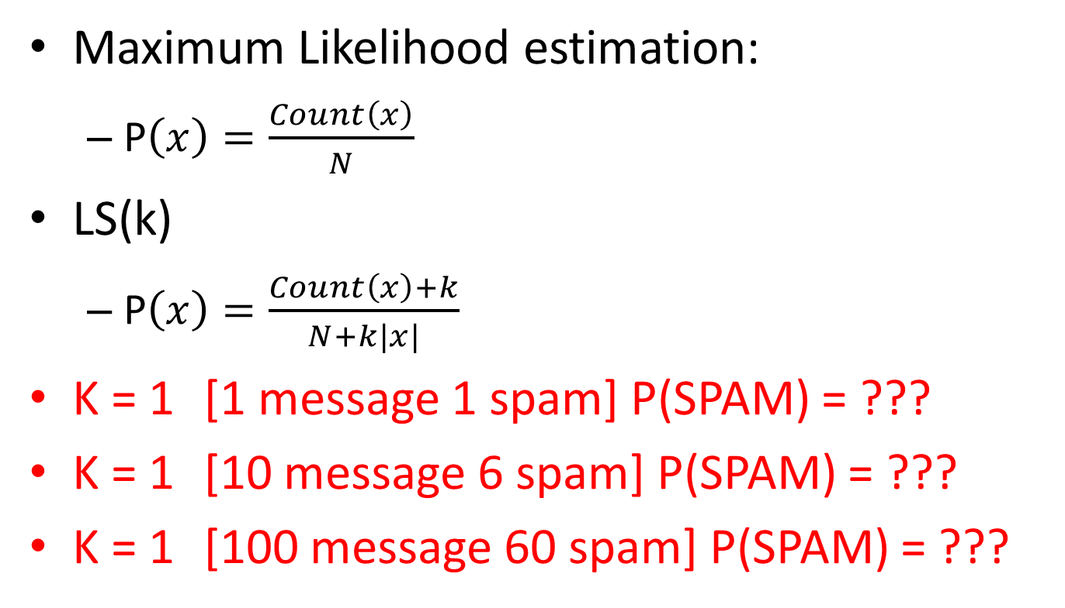
Laplace Smoothing
Maximum Likelihood estimation:
  P$\left(x\right)=\frac{Count\left(x\right)}{N}$
LS(k)
  P$\left(x\right)=\frac{Count\left(x\right)+k}{N+k|x|}$
K = 1 [1 message 1 spam] P(SPAM) = ???
K = 1 [10 message 6 spam] P(SPAM) = ???
K = 1 [100 message 60 spam] P(SPAM) = ???

Slide 27
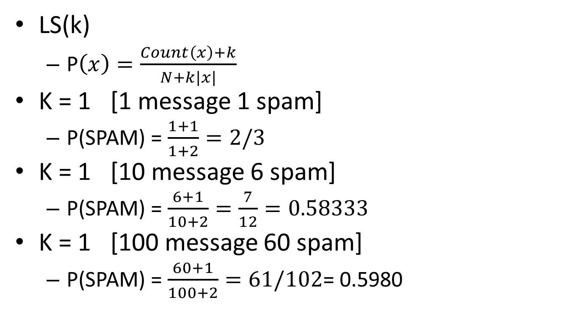
Laplace Smoothing - 2
LS(k)
  P
K = 1 [1 message 1 spam]
  P(SPAM) =
K = 1 [10 message 6 spam]
  P(SPAM) =
K = 1 [100 message 60 spam]
  P(SPAM) = = 0.5980

Slide 28
Laplace Smoothing - 3
SPAM
  Offer is secret
  Click secret link
  Secret sports link
HAM
  Play sports today
  Went play sports
  Secret sports event
  Sport is today
  Sport costs money
K = 1
  P(SPAM) = ???
  P(HAM) = ???

Slide 29
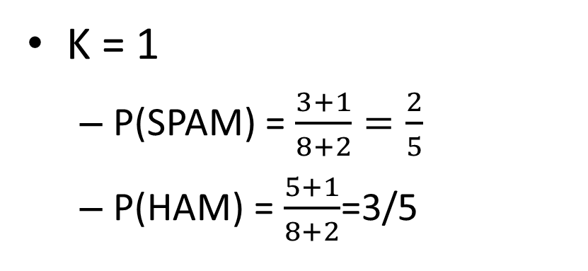
Laplace Smoothing - 4
SPAM
  Offer is secret
  Click secret link
  Secret sports link
HAM
  Play sports today
  Went play sports
  Secret sports event
  Sport is today
  Sport costs money
K = 1
  P(SPAM) = $\frac{3+1}{8+2}=\frac{2}{5}$
  P(HAM) = $\frac{5+1}{8+2}$=3/5
  P(“TODAY”|SPAM) = ???
  P(“TODAY”|HAM)= ???

Slide 30
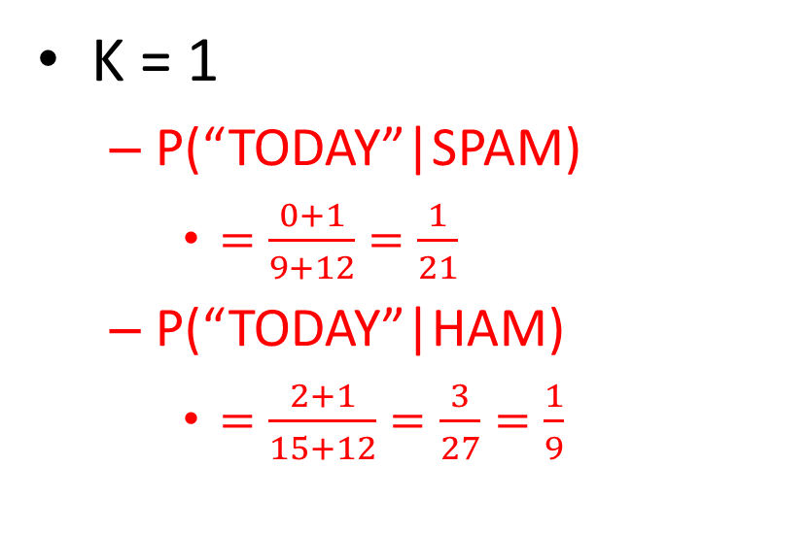
Laplace Smoothing - 4
SPAM
  Offer is secret
  Click secret link
  Secret sports link
HAM
  Play sports today
  Went play sports
  Secret sports event
  Sport is today
  Sport costs money
K = 1
  P(“TODAY”|SPAM)
    $=\frac{0+1}{9+12}=\frac{1}{21}$
  P(“TODAY”|HAM)
    $=\frac{2+1}{15+12}=\frac{3}{27}=\frac{1}{9}$

Slide 31
Laplace Smoothing - 4
SPAM
  Offer is secret
  Click secret link
  Secret sports link
HAM
  Play sports today
  Went play sports
  Secret sports event
  Sport is today
  Sport costs money
M = “TODAY IS SECRET”
P(SPAM|M) = ???
  K = 1

Slide 32
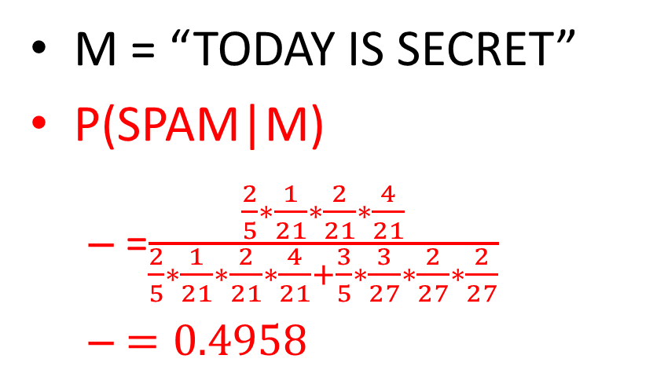
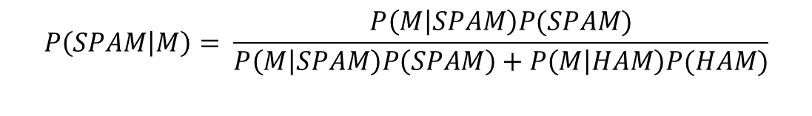
Laplace Smoothing - 4
SPAM
  Offer is secret
  Click secret link
  Secret sports link
HAM
  Play sports today
  Went play sports
  Secret sports event
  Sport is today
  Sport costs money
M = “TODAY IS SECRET”
P(SPAM|M)
  =
$$P\left(SPAM | M\right)= \frac{P\left(M | SPAM\right)P(SPAM)}{P\left(M | SPAM\right)P\left(SPAM\right)+P\left(M | HAM\right)P(HAM)}$$

Slide 33
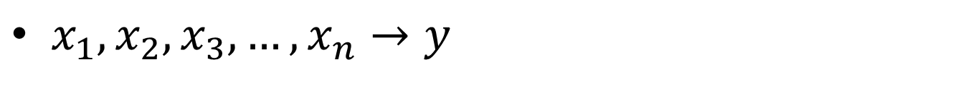
Summary Naïve Bayes
$x_{1},x_{2},x_{3}, …,x_{n}→y$
y
Generative model:
Bag-of-Words (BOW) model
Maximum Likelihood estimation
Laplace Smoothing
x1
x2
x3

Slide 34
Advanced SPAM Filters
Features:
  Does the email come from a known spamming IP or computer?
  Have you emailed this person before?
  Have 1000 other people recently received the same message?
  Is the email header consistent?
  All Caps?
  Do the inline URLs point to those pages where they say they're pointing to?
  Are you addressed by your correct name?
SPAM filters keep learning as people flag emails as spam, and of course spammers keep learning as well and trying to fool modern spam filters.

Slide 35
Overfitting Prevention
Occam’s Razor:
  there is a trade off between how well we can fit the data, and how smooth our learning algorithm is.
How do we determine the k in Laplace smoothing?
Cross-validation:
Training Data
Train
CV
Test
80%
10%
10%
Notes:
Take your training data and divide it into three buckets, Train, CV and Test.

Slide 36
Classification vs Regression
Supervised Learning
  Classification:
    To predict whether an Email is a SPAM or HAM
  Regression:
    To predict the temperature for tomorrow’s weather

Slide 37
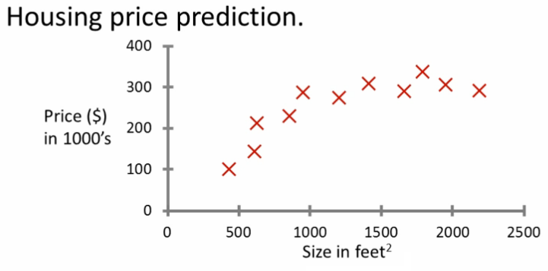
Regression Example
Given this data, a friend has a house of 1000 sq ft.
How much should he ask?
  200K?
  275K?
  300K?

Slide 38
Regression Example
Linear:
Maybe: 200K
Second order polynomial:
Maybe: 275K
Notes:
It’s different from classification. We are not asking about cheap or expensive. We care about the relationship between two variables. One you care about, and one you can observe.
I can come up a complex function that can fit the data really well, but by Occam’s razor, the simpler version, either the linear or polynomial function might explain the data better in a more general sense. Overfitting is evil.

Slide 39
Linear Regression
Data
  We are looking for y = f(x)
n=1, x is one-dimensional
High-dimensional: w is a vector

Slide 40
Linear Regression
Quiz:
  w₀ = ??
  w₁ = ??
x | y
3 | 0
6 | -3
4 | -1
5 | -2
Notes:
W₁ = -1
W0 = 3

Slide 41
Loss function
Loss function:
  Goal is to minimize the residue error after fitting the linear regression function as good as possible
  Quadratic Loss/Error:

Slide 42
Minimize Quadratic Loss
We are minimizing the quadratic loss, that is:

Slide 43
Minimize Quadratic Loss
Quiz:
  w₀ = ??
  w₁ = ??
x | y
3 | 0
6 | -3
4 | -1
5 | -2
Notes:
W₁ = -1
W0 = 3

Slide 44
Minimize Quadratic Loss
Quiz:
  w₀ = ??
  w₁ = ??
x | y
3 | 0
6 | -3
4 | -1
5 | -2
Notes:
W₁ = -1
W0 = 3

Slide 45
Quiz
Quiz:
  w₀ = ??
  w₁ = ??
x | y
2 | 2
4 | 5
6 | 5
8 | 8

Slide 46
Quiz
Quiz:
  w₀ = 0.5
  w₁ = 0.9
x | y
2 | 2
4 | 5
6 | 5
8 | 8

Slide 47
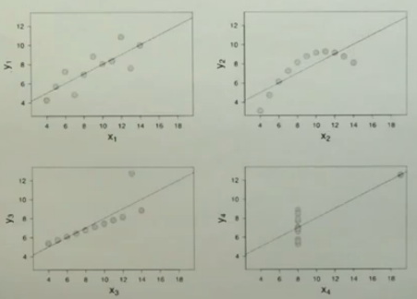
Problem with Linear Regression
Notes:
So linear regression works well if the data is approximately linear, but there are many examples when linear regression performs poorly.
This is an interesting one where we seem to have a linear relationship that is flatter than the linear regression indicates, but there is one outlier. Because if you are minimizing quadratic error, outliers penalize you over-proportionately. So outliers are particularly bad for linear regression.

Slide 48
Problem with Linear Regression
Temp
Days
Logistic Regression:
Quiz: Range of z?
a. (0,1)
b. (-1, 1)
c. (-1,0)
d. (-2, 2)
e. None
Notes:
Another problem with linear regression is that as you go to infinity in the X space, your Ys also become infinite. In some problems that isn't a plausible model. For example, if you wish to predict the weather anytime into the future, it's implausible to assume the further the prediction goes out, the hotter or the cooler it becomes.
For such situations there is a model called logistic regression, which uses a slightly more complicated model than linear regression

Slide 49
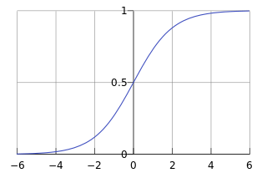
Logistic Regression
Logistic Regression:
Quiz: Range of z?
a. (0,1)

Slide 50
Regularization
Overﬁtting occurs when a model captures idiosyncrasies of the input data, rather than generalizing.
  Too many parameters relative to the amount of training data
P = 1, L1 regularization
P = 2, L2 regularization

Slide 51
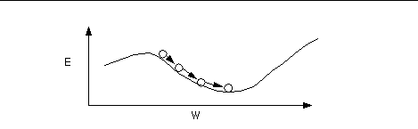
Minimize Complicated Loss Function
Close-form solution for minimize complicated loss function doesn’t always exist.
We need to use an iterative method
  Gradient Descent
a
c
b
Gradient of a, b, c; and whether they are positive, about zero or negative

Slide 52
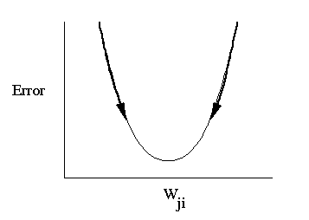
Quiz
c
c
a
Which gradient is the largest?
a??
b??
c??
equal?

Slide 53
Quiz
Will gradient descent likely reach the global minimum?
Loss
w

Slide 54
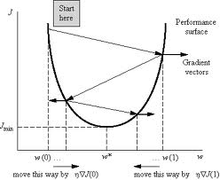
Global Minimum

Slide 55
Gradient Descent Implementation

Slide 56
Perceptron Algorithm
The perceptron is an algorithm for supervised classification of an input into one of two possible outputs.
It is a type of linear classifier, i.e. a classification algorithm that makes its predictions based on a linear predictor function combining a set of weights with the feature vector describing a given input.
In the context of artificial neural networks, the perceptron algorithm is also termed the single-layer perceptron, to distinguish it from the case of a multilayer perceptron, which is a more complicated neural network.
As a linear classifier, the (single-layer) perceptron is the simplest kind of feed-forward neural network.

Slide 57

Perceptron
Start with random guess for
error

Slide 58
Basis of SVM
Q: Which linear separate will you prefer?
c
a
b

Slide 59
Basis of SVM
Q: Which linear separate will you prefer?
b)
Maximum margin learning algorithms:
SVM
Boosting
c
a
b
The margin of the linear separator is the distance of the separator to the closest training example.

Slide 60
SVM
SVM derives a linear separator, and it takes the one that actually maximizes the margin
By doing so it attains additional robost-ness over perceptron.
The problem of finding the margin maximizing linear separator can be solved by a quadratic program which is an integer method for finding the best linear separator that maximizes the margin.
Notes:
As I said before a support vector machine derives a linear separator, and it takes the one that actually maximizes the margin as shown over here. By doing so it attains additional robost-ness over perceptron which only picks a linear separator without consideration of the margin.
Now the problem of finding the margin maximizing linear separator can be solved by a quadratic program which is an integer method for finding the best linear separator that maximizes the margin.

Slide 61
SVM
x2
Use linear techniques to solve nonlinear separation problems.
“Kernel trick”:
x1
x3
“An Introduction to Kernel-Based Learning Algorithms”
Notes:
In SVMs, the extension of the feature space is mathematically done by what's called a kernel.
makes it possible to write very large new feature spaces including infinitely dimensional new feature spaces.

Slide 62
k Nearest Neighbors
Parametric: # of parameters independent of training set size.
Non-parametric: # of parametric can grow
1-nearest Neighbors

Slide 63
kNN
Learning: memorize all data
Label New Example:
  Find k Nearest Neighbors
  Choose the majority class label as your final class label for the new example

Slide 64
kNN - Quiz
K=1
K=3
K=5
K=7
K=9

Slide 65
Problems of KNN
Very large data sets:
  KDD trees
Very large feature spaces

