Slide 1
CPSC 7373: Artificial Intelligence
Jiang Bian, Fall 2014
University of Arkansas for Medical Sciences
University of Arkansas at Little Rock

Slide 2
Lecture 3: Problem solving by searching
Outline
Problem-solving agents
Problem types
Problem formulation
Example problems
Basic search algorithms

Slide 3
Problem-solving agents
Problem-solving agent is one kind of goal-based agent.
Reflex agents: direct mapping from states to actions.
Size: too large to store
Speed: too long to learn
Goal-based agents:
consider future actions; and
The desirability of the outcomes

Slide 4
Problem-solving agents
Problems and solutions.
Goal formulation: based on the current situation and the agent’s performance measure;
Problem formulation: is the process of deciding what actions and states to consider, given a goal;
In an observable and deterministic world, the solution in any problem is a fixed sequence of actions.
Search solution: the process of looking for a sequence of actions that reaches the goal is called search.
“Formulate, search, execute” design of agents.

Slide 5
Well-defined problems and solutions
A problem can be defined formally by five components:
State space: a directed network (graph)
The initial state.
A list of the possible actions to the agent given a particular state.
Transition model: the consequence of the action
Input: current state, action
Output: next state
Goal test: are we there yet?
A path cost function: a cost function the agent choose to reflect its own performance measure.
Assumption: sum of step cost
A Solution to a problem is an action sequence that leads from the initial state to a goal state.
Optimal solution: measured by the path cost function.

Slide 6
Problem-solving agents

Slide 7
Example: Romania

Slide 8
Example: Romania
On holiday in Romania: currently in Arad.
Flight leaves tomorrow from Bucharest.
Formulate goal:
Be in Bucharest
Formulate problem:
States: various cities
Actions: drive between cities
Find solution:
Sequence of cities, e.g., Arad, Sibiu, Fagaras, Bucharest.
By searching, the process of looking for a sequence of actions that reaches the goal.

Slide 9
Problem types
Deterministic, fully observable → single-state problem
Agent knows exactly which state it will be in; solution is a sequence
Non-observable → sensorless problem (conformant problem)
Agent may have no idea where it is; solution is a sequence
Nondeterministic and/or partially observable → contingency problem
percepts provide new information about current state
often interleave search, execution
Unknown state space → exploration problem

Slide 10
Example: vacuum world
Single-state, start in #5. Solution?

Slide 11
Example: vacuum world
Single-state, start in #5. Solution? [Right, Suck]
Sensorless, start in {1,2,3,4,5,6,7,8} e.g., Right goes to {2,4,6,8}. Solution?

Slide 12
Example: vacuum world
Sensorless, start in {1,2,3,4,5,6,7,8} e.g., Right goes to {2,4,6,8}. Solution?
[Right, Suck, Left, Suck]
Contingency
Nondeterministic: Suck may dirty a clean carpet
Partially observable: location, dirt at current location
Percept: [L, Clean], i.e., start in #5 or #7
Solution?

Slide 13
Example: vacuum world
Contingency
Nondeterministic: Suck may dirty a clean carpet
Partially observable: location, dirt at current location
Percept: [L, Clean], i.e., start in #5 or #7
Solution?
[Right, if dirt then suck]

Slide 14
Single-state problem formulation
A problem is defined by four items:
Initial state: e.g., “at Arad”
Actions or Successor function S(x) = set of action-state pairs
e.g., S(Arad) = {<Arad → Zerind, Zerind>, … }
Goal test, can be
explicit, e.g., x = "at Bucharest"
implicit, e.g., Checkmate(x)
Path cost (additive)
e.g., sum of distances, number of actions executed, etc.
c(x,a,y) is the step cost, assumed to be ≥ 0
A solution is a sequence of actions leading from the initial state to a goal state

Slide 15
Selecting a state space
Real world is absurdly complex
→ state space must be abstracted for problem solving
(Abstract) state = set of real states
(Abstract) action = complex combination of real actions
e.g., "Arad → Zerind" represents a complex set of possible routes, detours, rest stops, etc.
For guaranteed realizability, any real state "in Arad“ must get to some real state "in Zerind”
(Abstract) solution =
set of real paths that are solutions in the real world
Each abstract action should be "easier" than the original

Slide 16
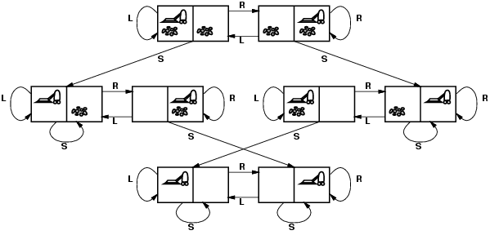
Vacuum world state space graph
states?
actions?
goal test?
path cost?

Slide 17
Vacuum world state space graph
states? integer dirt and robot location
actions? Left, Right, Suck
goal test? no dirt at all locations
path cost? 1 per action

Slide 18
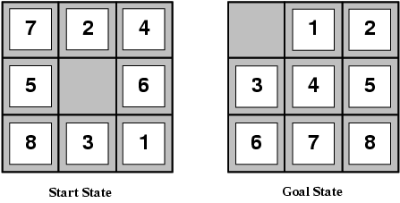
Example: The 8-puzzle
states?
actions?
goal test?
path cost?

Slide 19
Example: The 8-puzzle
states? locations of tiles
actions? move blank left, right, up, down
goal test? = goal state (given)
path cost? 1 per move
[Note: optimal solution of n-Puzzle family is NP-hard]

Slide 20
Searching for solutions
A solution (to a formulated problem) is an action sequence:
Search algorithms: considering various possible action sequences.
Search tree:
Root: initial state;
Branches: actions
Nodes: states in the state space of the problem.

Slide 21
Example: Route-finding in Romania
Notes:
All the cities here are the states
We navigate the state space through actions
Frontier – the farthest states that are explored
Unexplored, and explored region

Slide 22
Tree search example

Slide 23
Tree search
Function TREE-SEARCH(problem):
Frontier = {[initial]}
Loop:
If frontier is empty: return FAIL
Path = REMOVE-CHOICE(frontier)
s = path.end
If GOAL-TEST(s): return path
For a in Actions(s):
Add [path+a->Result(s,a)] to frontier
Notes:
\code{
\func{General-Search}{{\ts}\var{problem{\ac}strategy}}{a solution, or failure}
initialize the search tree using the initial state of \var{problem}
\key{loop} \key{do}
\key{if} there are no candidates for expansion \key{then} \key{return} failure
choose a leaf node for expansion according to \var{strategy}
\key{if} the node contains a goal state \key{then} \key{return} the corresponding solution
\key{else} expand the node and add the resulting nodes to the search tree
\key{end}
}
REMOVE-CHOICE is the kernel of the tree search algorithms (breadth-first, uniform cost/cheapest, depth first)

Slide 24
Uninformed/blind search strategies
Uninformed search strategies use only the information available in the problem definition
Breadth-first search
Uniform-cost/cheapest search
Depth-first search
Depth-limited search
Iterative deepening search
Notes:
Consider 4 criteria of each searching stragegy

Slide 25
Search strategies
A search strategy is defined by picking the order of node expansion
Strategies are evaluated along the following dimensions:
completeness: does it always find a solution if one exists?
time complexity: number of nodes generated
space complexity: maximum number of nodes in memory
optimality: does it always find a least-cost solution?
Time and space complexity are measured in terms of
b: maximum branching factor of the search tree
d: depth of the least-cost solution
m: maximum depth of the state space (may be ∞)

Slide 26
Breadth-first search
If we decide to explore Sibiu first, what are our options according to the tree search algorithm?

Slide 27
Breadth-first search
If we decide to explore Sibiu first, what are our options according to the tree search algorithm?
Oradea, Fagaras, Rimnicu Vilcea, and Arad
Notes:
It’s obvious that going back to Arad is redundant, but tree search doesn’t know that.

Slide 28
Tree search example

Slide 29
Tree search example

Slide 30
Tree search example
Notes:
In the tree, Arad is just another node

Slide 31
Graph search
Function GRAPH-SEARCH(problem):
frontier = {[initial]}; explored = {}
Loop:
If frontier is empty: return FAIL
Path = REMOVE-CHOICE(frontier)
s = path.end; add s to explored
If GOAL-TEST(s): return path
For a in Actions(s):
Add [path+a->Result(s,a)] to frontier
Unless Result(s,a) in frontier or explored

Slide 32
Breadth-first search
If we decide to explore Sibiu first, what are our options according to the graph search algorithm?
Oradea, Fagaras, Rimnicu Vilcea
After we added the three states/cities to the frontier list, what are our next choices according to the breadth-first search strategy?

Slide 33
Breadth-first search
After we explored the three states/cities, what are our next choices according to the breadth-first search strategy?
Zerind, and Timsioara
Breadth-first is always looking at the paths with minimum number of steps

Slide 34
Breadth-first search
Let’s say we use a random algorithm to pick Zerind as the next state to explore. After remove Zerind from the frontier, what paths are we going to add to the frontier list according to the graph search algorithm?

Slide 35
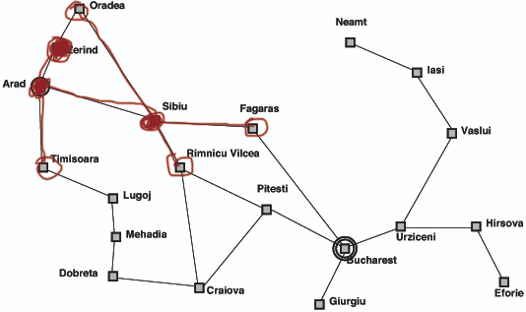
Breadth-first search
After remove Zerind from the frontier, what paths are we going to add to the list according to the graph search algorithm?
None, because Arad is in the explored list, and Oradea is in the frontier list

Slide 36
Breadth-first search
Consider Fagaras, which path are we going to explore/add to the frontier? And are we ready to terminate?

Slide 37
Breadth-first search
Consider Fagaras, which path are we going to explore/add to the frontier? And are we ready to terminate?
Bucharest
No (Goal-Test is when we remove the path from the frontier, not when we are adding)
Notes:
Breadth-first doesn’t know whether it’s is the optimal path.
We can do that, if we keep tracking of the number of the steps.

Slide 38
Properties of breadth-first search
Complete??
Time??
Space??
Optimal??

Slide 39
Search strategies measurements
Strategies are evaluated along the following dimensions:
completeness: does it always find a solution if one exists?
time complexity: number of nodes generated
space complexity: maximum number of nodes in memory
optimality: does it always find a least-cost solution?
Time and space complexity are measured in terms of
b: maximum branching factor of the search tree
d: depth of the least-cost solution
m: maximum depth of the state space (may be ∞)
Notes:
For time complexity, b, d, and m control how many steps you need to explore; for space complexity, these variables control how much storage space you need to track the states

Slide 40
Properties of breadth-first search
Complete? Yes (if b is finite)
Time? 1+b+b²+b³+… +b^{d} + b(b^{d}-1) = O(b^{d+1})
Space? O(b^{d+1}) (keeps every node in memory)
Optimal? Yes (if cost = 1 per step)
Space is the bigger problem (more than time)

Slide 41
Uniform/cheapest cost search
Let’s start from the initial state (Arad), and we have three options.
Which one are we going to explore next according to the cheapest first rule?

Slide 42
Uniform/cheapest cost search
Which one are we going to explore next according to the cheapest first rule?
Zerind (75)
What’s next?

Slide 43
Uniform/cheapest cost search
What’s next?

Slide 44
Uniform/cheapest cost search
What’s next?

Slide 45
Uniform/cheapest cost search

Slide 46
Properties of uniform cost search
Expand least-cost unexpanded node
Equivalent to breadth-first if step costs all equal
Complete? Yes, if step cost ≥ ε(each action has non-zero cost)
Time? # of nodes with g ≤ cost of optimal solution, O(b^{ceiling(C*/ ε)}) where C* is the cost of the optimal solution
Space? # of nodes with g ≤ cost of optimal solution, O(b^{ceiling(C*/ ε)})
Optimal? Yes – nodes expanded in increasing order of g(n)
Notes:
Consider an infinite path whose costs sum as follows: 1 + 1/2 + 1/4 + 1/8 + 1/16 + 1/32 + ... The infinite sum of this series is 2. If the shortest path to the goal node has cost greater than 2, cheapest first search will be incomplete.
In the case of an infinite tree, cheapest first is complete only if
(1) each action has a non-zero cost separate from the path cost and
(2) no node has an infinite number of successors.

Slide 47
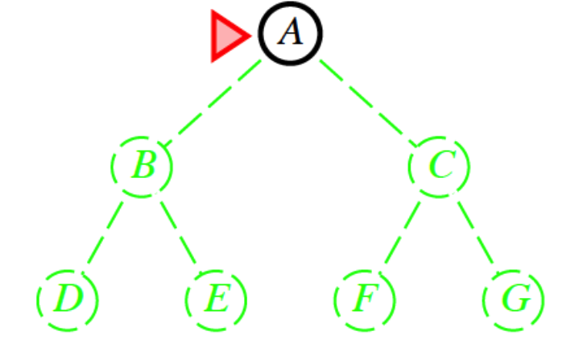
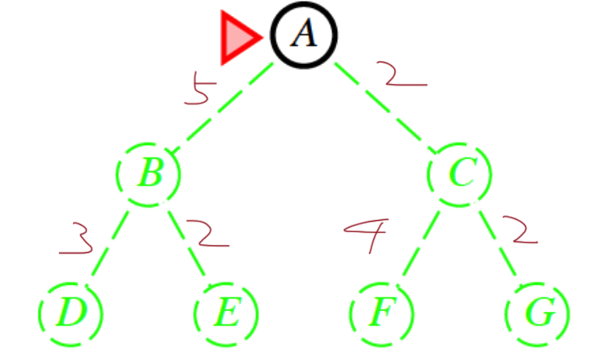
Search comparison
Breadth-first search
Cheapest-first search
Depth-first search

Slide 48
Properties of depth-first search
Complete? No: fails in infinite-depth spaces, spaces with loops
Modify to avoid repeated states along path
complete in finite spaces
Depth-limited search, Iterative deepening search
Time? O(b^{m}): terrible if m is much larger than d
but if solutions are dense, may be much faster than breadth-first
Space? O(bm), i.e., linear space!
Optimal? No

Slide 49
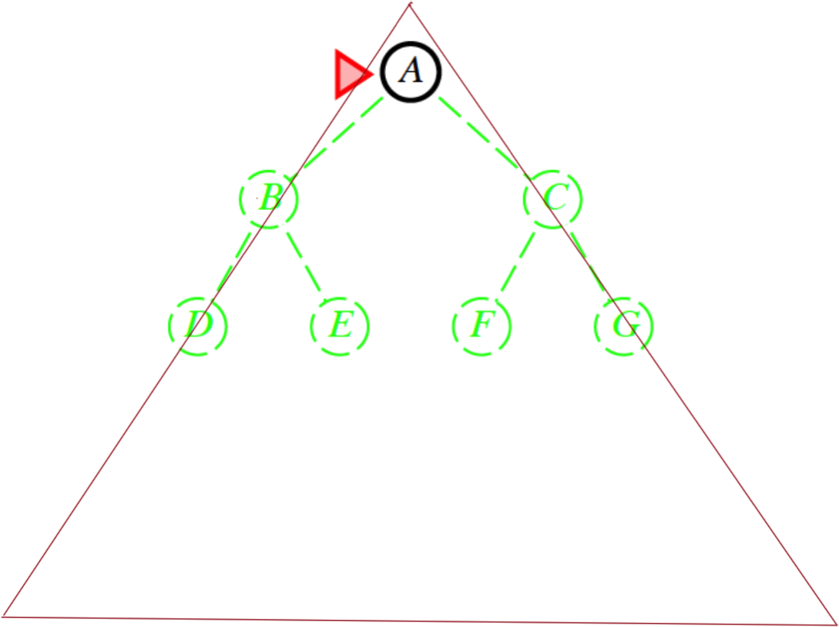
Search comparison
1
.
.
.
.
.
n
Frontier? 2^n v.s. n
Infinite search tree:
Complete??
Breadth-first search
1
.
.
.
.
.
n
1
.
.
.
.
.
n
Cheapest-first search
Depth-first search

Slide 50
More on uniform cost search
We are expanding in terms of contours on a topological map.
At some point we meet the goal state and we find a path to the goal.
The search is not directed to the goal state (i.e., we are expanding at every direction).
It is a problem when the space is large.
What do we do?
We need to add more knowledge.
A estimate function (i.e., h(n) heuristic) to the goal
Notes:
At some point we meet the goal state and we find a path to the goal.

Slide 51
Greedy best-first search
It expands first the path that closet to the goal according to the estimate.
Greedy search expands the node that appears to be closest to goal

Slide 52
Example: Rout finding in Romania
Heuristic: h(n) – e.g., h_{SLD}(n) = straight-line distance from n to Bucharest

Slide 53
Greedy best-first search example

Slide 54
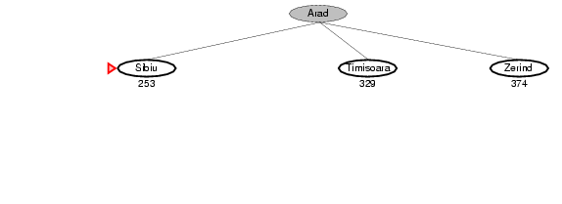
Greedy best-first search example

Slide 55
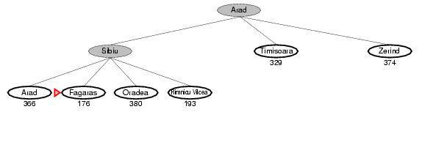
Greedy best-first search example

Slide 56
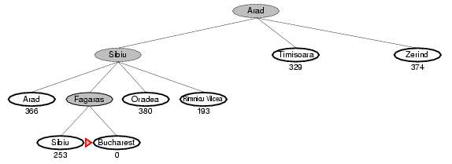
Greedy best-first search example

Slide 57
Properties of greedy best-first search
Complete? No – even in infinite state space can get stuck in loops for the tree-search version, e.g., with Oradea as goal, start from Iasi → Neamt → Iasi → Neamt →
For the graph-search version, it is complete in finite state space; not complete in infinite state space.
Time? O(b^{m}), but a good heuristic can give dramatic improvement
Space? O(b^{m}) -- keeps all nodes in memory
Optimal? No

Slide 58
Example: Rout finding in Romania
Heuristic: h(n) – e.g., h_{SLD}(n) = straight-line distance from n to Bucharest

Slide 59
Search strategies measurements
Strategies are evaluated along the following dimensions:
completeness: does it always find a solution if one exists?
time complexity: number of nodes generated
space complexity: maximum number of nodes in memory
optimality: does it always find a least-cost solution?
Time and space complexity are measured in terms of
b: maximum branching factor of the search tree
d: depth of the least-cost solution
m: maximum depth of the state space (may be ∞)
Notes:
For time complexity, b, d, and m control how many steps you need to explore; for space complexity, these variables control how much storage space you need to track the states

Slide 60
Greedy best-first search with obstacle
What if there are obstacles in greedy best-first search?

Slide 61
A* search
Idea: avoid expanding paths that are already expensive
Evaluation function:
f(n) = g(n) + h(n)
g(n): cost so far to reach n
h(n): estimated cost to goal from n
f(n): estimated total cost of path through n to goal
A* search uses an admissible heuristic
i.e., h(n) <= h*(n), where h*(n) is the true cost from n
Do not overestimate. What about underestimate?
e.g., h_{SLD}(n) never overestimates the actual road distance
Theorem: A* search is optimal??

Slide 62
Example: Rout finding in Romania
f(n) = g(n) + h(n)
h(n): h_{SLD}(n) = straight-line distance from n to Bucharest
g(n): cost to reach n

Slide 63
A* search example

Slide 64
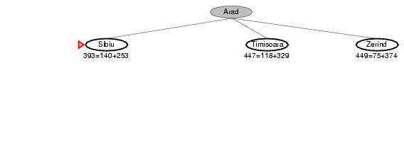
A* search example

Slide 65
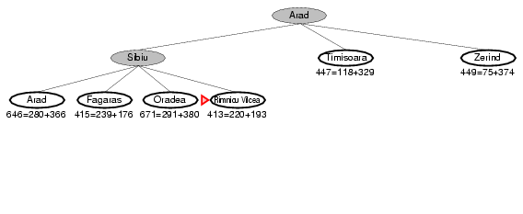
A* search example

Slide 66
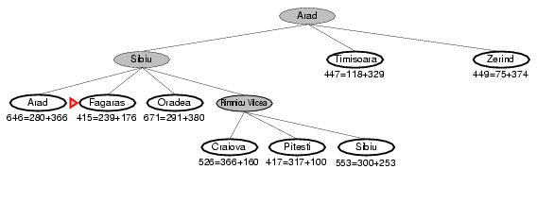
A* search example

Slide 67
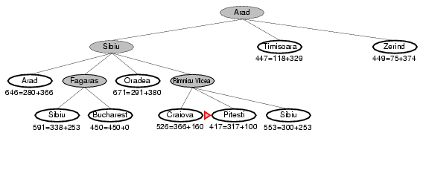
A* search example

Slide 68
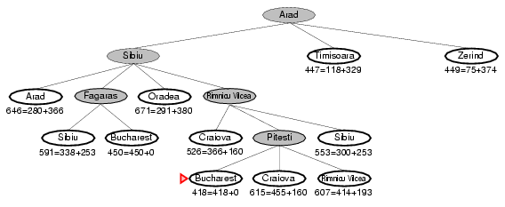
A* search example

Slide 69
Admissible heuristics
A heuristic h(n) is admissible if for every node n,
h(n) ≤ h*(n), where h*(n) is the true cost to reach the goal state from n.
An admissible heuristic never overestimates the cost to reach the goal, i.e., it is optimistic
Example: h_{SLD}(n) (never overestimates the actual road distance)
Theorem: If h(n) is admissible, A* using TREE-SEARCH is optimal

Slide 70
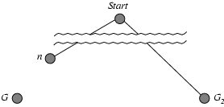
Optimality of A* (proof)
Suppose some suboptimal goal G₂ has been generated and is in the frontier. Let n be an unexpanded node in the frontier such that n is on a shortest path to an optimal goal G.
f(G₂) = g(G₂) since h(G₂) = 0
g(G₂) > g(G) since G₂ is suboptimal
f(G) = g(G) since h(G) = 0
f(G₂) > f(G) from above
f(n) = g(n) + h(n)

Slide 71
Optimality of A* (proof)
Suppose some suboptimal goal G₂ has been generated and is in the fringe. Let n be an unexpanded node in the fringe such that n is on a shortest path to an optimal goal G.
f(G₂) > f(G) from above
h(n) ≤ h^*(n) since h is admissible
g(n) + h(n) ≤ g(n) + h*(n)
f(n) ≤ f(G)
Hence f(G₂) > f(n), and A* will never select G₂ for expansion

Slide 72
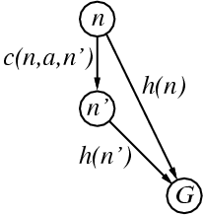
Consistent heuristics
A heuristic is consistent if for every node n, every successor n' of n generated by any action a,
h(n) ≤ c(n,a,n') + h(n')
If h is consistent, we have
f(n') = g(n') + h(n')
= g(n) + c(n,a,n') + h(n')
≥ g(n) + h(n)
= f(n)
i.e., f(n) is non-decreasing along any path.
Theorem: If h(n) is consistent, A* using GRAPH-SEARCH is optimal

Slide 73
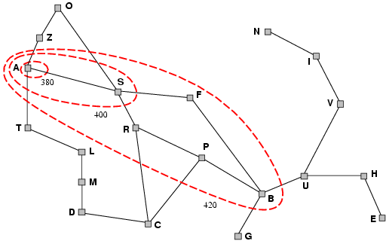
Optimality of A*
A* expands nodes in order of increasing f value Gradually adds "f-contours" of nodes
Contour i has all nodes with f=f_{i}, where f_{i} < f_{i+1}

Slide 74
Properties of A*
Complete? Yes (unless there are infinitely many nodes with f ≤ f(G) )
Time? Exponential
Space? Keeps all nodes in memory
Optimal? Yes

Slide 75
Homework: n-puzzle solver
Solvability (http://www.cs.bham.ac.uk/~mdr/teaching/modules04/java2/TilesSolvability.html)
If the grid width is odd, then the number of inversions in a solvable situation is even.
If the grid width is even, and the blank is on an even row counting from the bottom (second-last, fourth-last etc), then the number of inversions in a solvable situation is odd.
If the grid width is even, and the blank is on an odd row counting from the bottom (last, third-last, fifth-last etc) then the number of inversions in a solvable situation is even.
That gives us this formula for determining solvability:
( (grid width odd) && (#inversions even) ) || ( (grid width even) && ((blank on odd row from bottom) == (#inversions even)) )

Slide 76
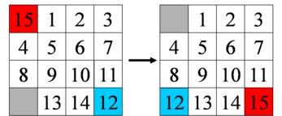
Manhattan Distance
http://heuristicswiki.wikispaces.com/Manhattan+Distance

Slide 77
IDA*
A*, like depth-first search, except based on increasing values of total cost rather than increasing depths
IDA* sets bounds on the heuristic cost of a path, instead of depth
IDA* is optimal in terms of solution cost, time, and space for admissible best-first searches on a tree

Slide 78
IDA*
Each iteration is a depth-first search that keeps track of the cost evaluation f(n) = g(n) + h(n) of each node generated.
If a node is generated whose cost exceeds the threshold for that iteration, its path is cut off.
The cost threshold is initialized to the heuristic of the initial state.
The cost threshold increases in each iteration to the total cost of the lowest-cost node that was pruned during the previous iteration.
The algorithm terminates when a goal state is reached whose total cost does not exceed the current threshold.

Slide 79
node current node
g the cost to reach current node
f estimated cost of the cheapest path (root..node..goal)
h(node) estimated cost of the cheapest path (node..goal)
cost(node, succ) path cost function
is_goal(node) goal test
successors(node) node expanding function
procedure ida_star(root, cost(), is_goal(), h())
bound := h(root)
loop
t := search(root, 0, bound)
if t = FOUND then return FOUND
if t = ∞ then return NOT_FOUND
bound := t
end loop
end procedure

Slide 80
function search(node, g, bound)
f := g + h(node)
if f > bound then return f
if is_goal(node) then return FOUND
min := ∞
for succ in successors(node) do
t := search(succ, g + cost(node, succ), bound)
if t = FOUND then return FOUND
if t < min then min := t
end for
return min
end function

