Slide 1
CPSC 7373: Artificial Intelligence Lecture 7: Unsupervised Learning
Jiang Bian, Fall 2014
University of Arkansas for Medical Sciences
University of Arkansas at Little Rock

Slide 2
Unsupervised Learning
Supervised learning:
Given data and target labels
Unsupervised learning;
Given data only
To find structures (patterns)

Slide 3
Unsupervised learning
Is there a structure?
Yes/No
X2
x
x
x
x
x
x
x
x
x
x
x
x
x
x
x
x
x
x
X1

Slide 4
Unsupervised learning
How many clusters?
X2
x
x
x
x
x
x
x
x
x
x
x
x
x
x
x
x
x
x
X1

Slide 5
Clustering
Tasks
To identify the number of clusters
To find the center of the clusters
To find the variance of the clusters
X2
x
x
x
x
x
x
x
x
x
x
x
x
x
x
x
x
x
x
X1

Slide 6
Quiz
What is the dimensionality of the space?
How many dimensions are intuitively needed to capture the essence of the data?
X2
x
x
x
x
x
x
x
x
x
x
x
x
X1

Slide 7
Quiz
What is the dimensionality of the space?
2
How many dimensions are intuitively needed to capture the essence of the data?
1
X2
x
x
x
x
x
x
x
x
x
x
x
x
X1
Clustering
Dimensionality reduction:
Lower dimensionality of the data

Slide 8
Terminology
X2
Probability distribution:
IID: Identically distributed and independently drawn from the same distribution.
Density estimation: Identify the density of the underline probability distribution that generates the data.
Clustering/Dimensionality reduction
e.g. Blind signal separation
Factor analysis
x
x
x
x
x
x
x
x
x
x
x
x
x
x
x
x
x
x
X1

Slide 9
Example: Google street view
Concepts discoveries:
Houses, Trees, pavements, cars, etc.
Learn from observations without target labels
Andrew Ng, “How many computers to identify a Cat? 16,000” from the New York Times

Slide 10
Clustering
Two methods:
k-Means
Expectation maximization
Probabilistic generalization of k-Means.

Slide 11
K-Means Clustering
x
x
x
x
x
x
x
x
K-means (MacQueen, 1967) is one of the simplest unsupervised learning algorithms that solve the well known clustering problem. The procedure follows a simple and easy way to classify a given data set through a certain number of clusters (assume k clusters) fixed a priori.

Slide 12
k-Means Algorithm
Suppose that we have n sample feature vectors x1, x2, ..., xn all from the same class, and we know that they fall into k compact clusters, k < n. Let mi be the mean of the vectors in cluster i. If the clusters are well separated, we can use a minimum-distance classifier to separate them. That is, we can say that x is in cluster i if || x - mi || is the minimum of all the k distances. This suggests the following procedure for finding the k means:
Make initial guesses for the means m1, m2, ..., mk
Until there are no changes in any mean
Use the estimated means to classify the samples into clusters
For i from 1 to k
Replace mi with the mean of all of the samples for cluster i
end_for
end_until
http://home.dei.polimi.it/matteucc/Clustering/tutorial_html/AppletKM.html

Slide 13
Problems of k-Means
Need to know k
Local minima
High dimensionality
Lack of mathematical bases
x
x
x
x

Slide 14
k-Means Quiz -1
x
Which points belong to the blue point?
x
x
x
x
x
x

Slide 15
k-Means Quiz -1
x
Which of the yellow point is my new center for Cluster 1?
x
x
x
x
x
x

Slide 16
k-Means Quiz -1
x
Which points belong to the blue point?
x
x
x
x
x
x

Slide 17
k-Means Quiz -1
x
Which points belong to the blue point?
x
x
x
x
x
x

Slide 18
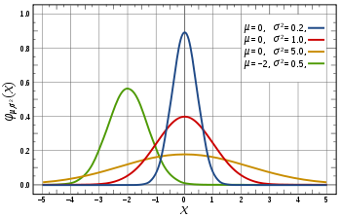
Expectation Maximization
k-Means -> Expectation Maximization
Gaussians: Normal Distribution (continuous distribution).
In probability theory, a probability density function (pdf), or density of a continuous random variable, is a function that describes the relative likelihood for this random variable to take on a given value.
Notes:
The mean is mu, the variance is sigmal
Peaks at x=mu, and towards x= -inf or x= inf, the function decreases exponentially fast
Quadratic function
Normalizer to make sure the the area underneath equal to 1 (for any PDF)
For each possible x, we can assign a density value (the probability that x will be drawn). Since the x space is inf, for any x, the probability will be 0, however, we can chose a range x = [a, b]
It’s more likely to generate value from mu

Slide 19
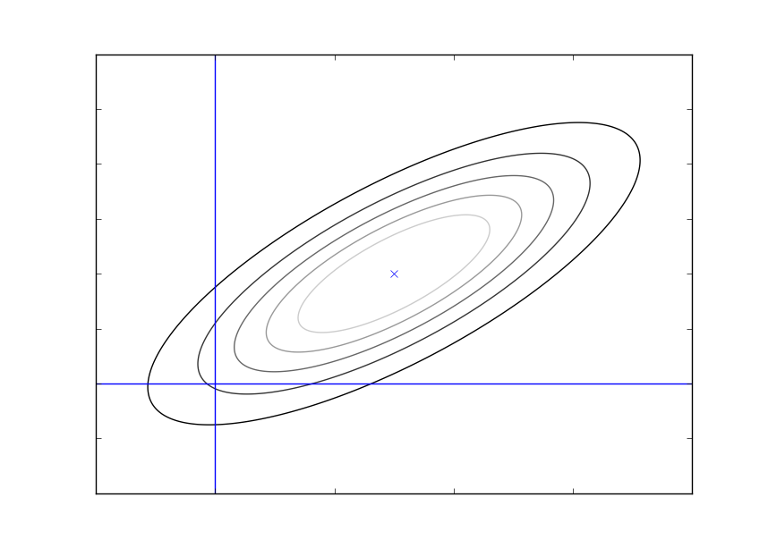
Multivariate Gaussian

Slide 20
Gaussian Learning
Parameters of a Gaussian:
Fitting Data:
Average
x
x
x
x
x
x
x
x
Average deviation

Slide 21
Maximum Likelihood
Data:
Max

Slide 22
Quiz - 1
3, 4, 5, 6, 7
M=5
???

Slide 23
Quiz - 1
3, 4, 5, 6, 7
M=5

Slide 24
Quiz - 2
3, 9, 9, 3

Slide 25
Quiz - 2
3, 9, 9, 3

Slide 26
Quiz 3
3 | 8
4 | 7
5 | 5
6 | 3
7 | 2
X=

Slide 27
Quiz 3
3 | 8
4 | 7
5 | 5
6 | 3
7 | 2
-2 | 3
-1 | 2
0 | 0
1 | -2
2 | -3
X=
X-u =

Slide 28
Gaussian Summary
Probability Density Function:
Fit from the data
Multivariate Gaussians

Slide 29
Expectation Maximization
EM as Generalization of k-Means
x
x
x
x
x
x
x
x
Each point is attracted to a center to the proportion of the posterior likelihood.
http://en.wikipedia.org/wiki/Expectation%E2%80%93maximization_algorithm
Notes:
Each point is attracted to a center to the proportion of the posterior likelihood.

Slide 30
EM Algorithm
Prior probability of each cluster:
For each class:
E-Step: Assume we know
M-Step:
Notes:
Each point is drawn from a mixture.
First draw cluster center, then draw from the guassian for each cluster center

Slide 31
EM Quiz - 1
X1 Correspond to C1 or C2?
x
x1
x
C2
x
C1

Slide 32
EM Quiz - 2
What is the shape of the Gaussian?
Circular
elongated
x
x
x

Slide 33
Quiz EM vs k-Means
EM
C1->A
C1->B
K-Means
C1->A
C1->B
x
C2
x
C1
x
x
A
B
C
D

Slide 34
Choosing k
# of clusters k?
Minimize:
Guess initial k
Run EM
Remove unnecessary clusters
Create new random clusters

Slide 35
Clustering summary
K-Means
Expectation Maximization

Slide 36
Dimensionality Reduction
Project the two-dimensional space (x1, x2) to a one dimensional space (x3).
The orthogonal of x3 carries virtually no information about the dataset.
X3
X2
x
x
x
x
x
x
x
x
x
x
x
x
X1

Slide 37
Quiz
X2
x
x
x
x
x
x
x
x
x
x
x
x
X1
How many dimensions do we REALLY need?

Slide 38
Quiz
X2
x
x
x
x
x
x
x
x
x
x
x
x
X1
How many dimensions do we REALLY need? 1
However, no-linear projection

Slide 39
Linear Dimensionality Reduction
1) Fit a Gaussian
2) Calculate the eigenvalues and eigenvectors
3) Pick eigenvectors which maximum eigenvalues
4) Project data onto your chosen eigenvectors
X1’
X2
x
x
x
x
x
x
x
x
x
X2’
x
x
x
X1

Slide 40
Eigenvectors and eigenvalues
X1 X2
0 1.9
1 3.1
2 4
3 5.1
4 5.9
Notes:
This is the eigenvector that dominates the spread of the data (with a large eigenvalue).

Slide 41
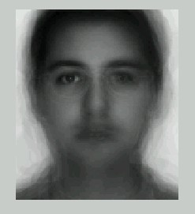
Example: Eigenface
Notes:
The overall problem is to be able to accurately recognize a person's identity and take some action based on the outcome of the recognition process. Recognize a person's identity is important mainly for security reason, but it could also be used to obtain quick access to medical, criminal, or any type of records.
High dimension space (50x50) pixels 2500 feature spaces. However, the image could be anything (cloud, car, etc.) but not a face. So, eigenface assumption is that the features of a face is actually a much smaller space.

Slide 42
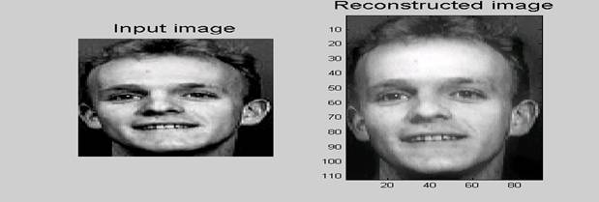
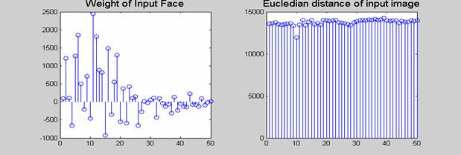
Eigenface
Maximum Value = 14266
Minimum Value =11919
Face: [11000, 15000]

Slide 43
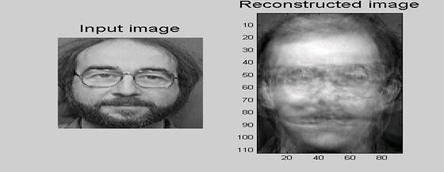
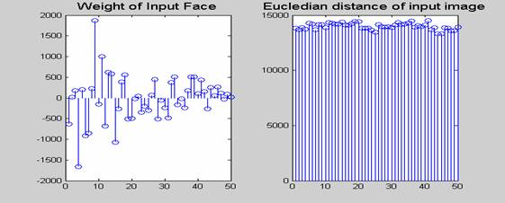
Eigenface
Maximum Value = 14506
Minimum Value = 13321
Face: [11000, 15000]

Slide 44
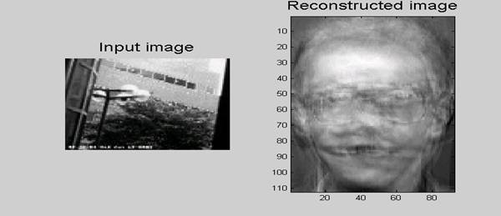
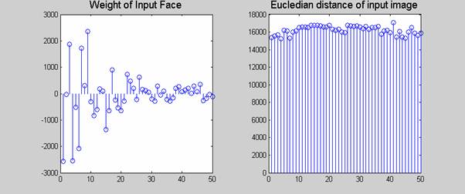
Eigenface
Max Value = 17072
Min Value = 15260

Slide 45
Eigenface - 2
These are the eigenfaces of our set of original images

Slide 46
Piece-wise linear projection
Dimensionality Reduction
Local linear embedding
ISO Map
x
x
x
x
x
x
x
x
Notes:
Define nonlinear sometimes piece-wise linear subspaces.
This is closely related to k-nearest neighbhour problem where we try to make sure the defined subspace is a feasible subspace.

Slide 47
Spectral Clustering
Q: Will EM/K-Means work in this case?
clustering by affinity
Notes:
The cluster is not defined (cannot) by the center, but defined by affinity. The relationship between points (similarity).

Slide 48
Spectral Clustering: Tutorial
Affinity = 1 /(quadratic distance)
Notes:
Quadratic distance

Slide 49
Spectral Clustering: PCA
Rank Deficient Matrix
(row/column) vectors of the same class are similar.
Principal Component Analysis (PCA): is a method to identify vectors that are similar in a approximate rank deficient matrix.
Notes:
Quadratic distance

Slide 50
Spectral Clustering: PCA
Eigenvectors
eigenvalues
Dimensionality: # of large eigenvalues
Notes:
The eigenvectors with small eigenvalues are not required to explain the dataset.

Slide 51
Spectral Clustering: PCA - 2
Affinity = 1 /(quadratic distance)
Notes:
Quadratic distance

Slide 52
Spectral Clustering: PCA -2

Slide 53
Spectral Clustering
Q: How many elements do we have in the affinity matrix?
Q: How many large eigenvalues?
Notes:
Quadratic distance

Slide 54
Supervised vs Unsupervised
Supervised
Unsupervised

